Slide 1
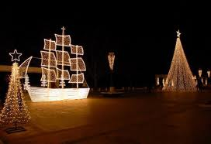
CHRISTMAS IN OUR TOWN
CHRISTMAS IN OUR TOWN

Slide 2
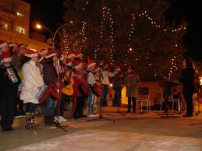
CHRISTMAS CAROLS

Slide 3
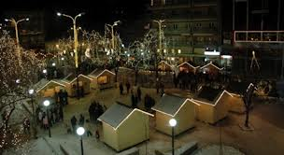
CHRISTMAS VILLAGE

Slide 4
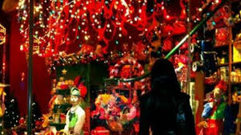
SHOP WINDOW

Slide 5
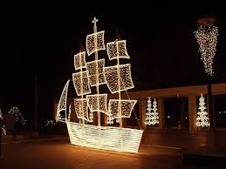
TRADITIONAL DECORATION

