Slide 1
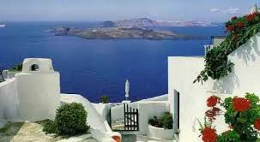
SUMMER IN GREECE

Slide 2
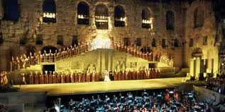
IS FULL OF FESTIVALS

Slide 3
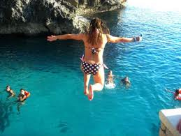
AND FUN

Slide 4
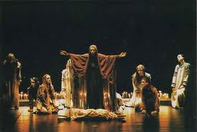
TRAGEDIES IN ANCIENT THEATRES

Slide 5
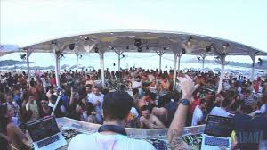
PARTIES AT THE BEACH

Slide 6
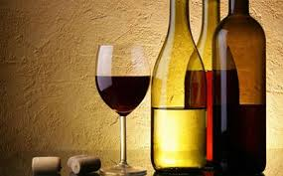
THERE ARE WINE FESTIVALS

Slide 7
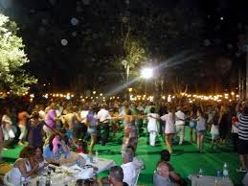
WHERE PEOPLE DANCE

Slide 8
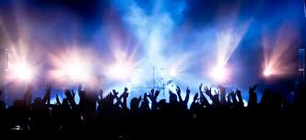
ROCK MUSIC FESTIVALS

