Slide 1
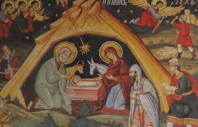
THE FIRST CHRISTMAS
A Byzantine icon

Slide 2
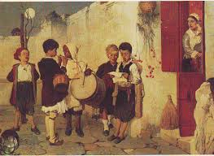
Carols in Greece 100 years ago

Slide 3
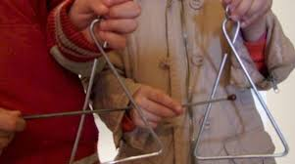
Carols today: Children go from house to house singing carols on 24th December and 31st December

Slide 4
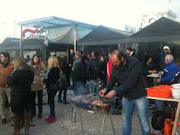
On December 31st there barbeques all over our town and free wine for everybody…

Slide 5
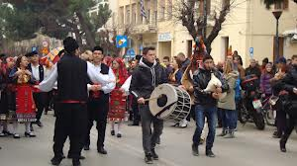
…and traditional music

Slide 6
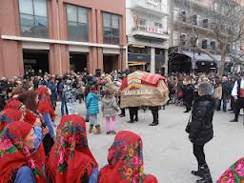
And dancing

Slide 7
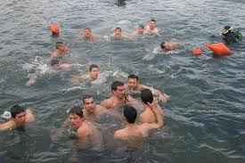
On January 6th (Epiphany) daring young men dive into the sea to catch the cross which is thrown in the water by a priest after a ceremony

